Slide 1
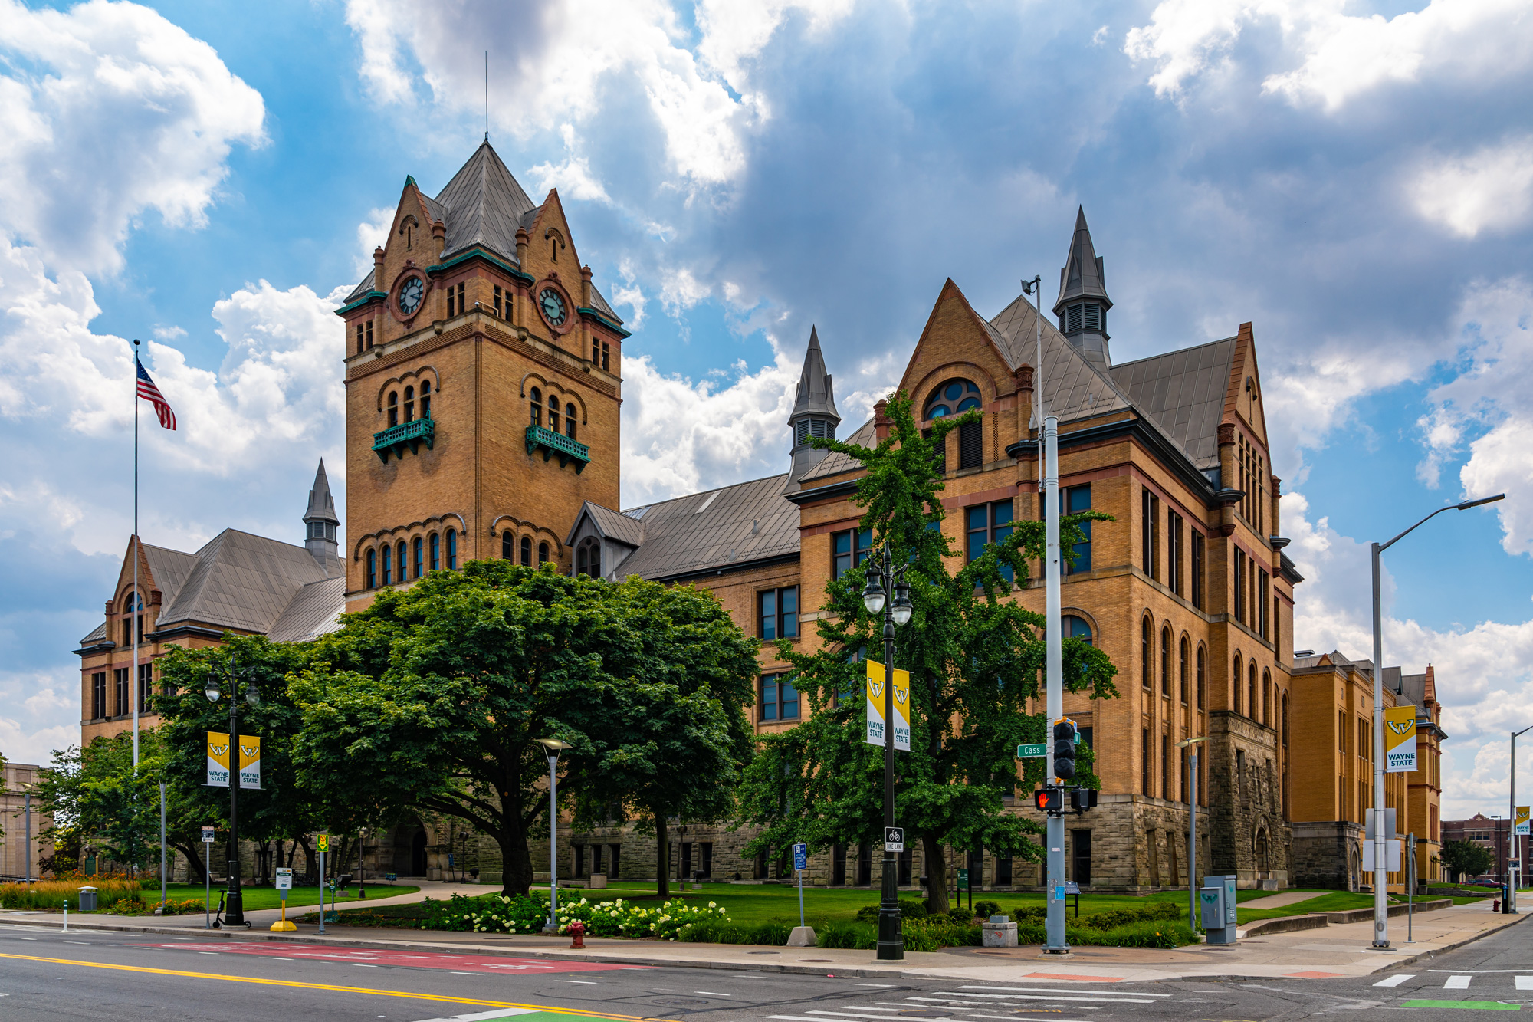
Title – this is a 60” x 36” (5’ x 3’) poster, 88 point Lato title heading, legible at 16 feet away. This is half size to be printed at 200%
Authors and affiliations
60 point Lato medium body
Introduction
Conclusion
Any posters that are meant to be read at a minimum distance; the following sizes are suggested:
Title: 88 pt bolded
Authors and affiliations: 54 - 60 pt
Headings: 48 pt
Body text: 24 - 32 pt
Captions: 18 pt
Text and figures should be readable from around 5-7 feet away
Use a sans serif typeface (e.g., Lato, Arial, Open Sans, Helvetica, etc.). Our poster templates use the sans serif font Lato, which can be downloaded from the link provided on our FAQ page or from Google: https://fonts.google.com/specimen/Lato
This poster uses Lato font and the theme has been mapped to that font. If you copy/paste text from documents, please ensure fonts are correct. Mismatched fonts in posters are a distraction and aesthetically degrades the quality of your presentation.
For more information about creating accessible design with color and type, please reference https://medcom.med.wayne.edu/creating-accessible-design
Key finding goes here, stated simply in common language. Highlight key points and key words.
Paragraph making statement to further expound upon headline in a few sentences.
WSU color branding quick guide. For detailed information about WSU color branding, please visit the FAQ section on our website and select the WSU color under the WSU branding section.
WSU primary green
hex (#0c5449) rgb (12, 84, 73)
WSU primary yellow
hex (#ffcc33) rgb (255, 204, 51)
Grey accent
hex (#d9d9d9) rgb (217, 217, 217)
Text – poor/inaccessible examples
Text should be high contrast, the example illustrates the worst examples of contrast, making it inaccessible for individuals that have vision impairment. This is what's called “designed to fail” as this assumes everyone can read the content, however, it does the opposite – it excludes people with vision impairments (and even good sighted individuals).
Black on white
Light green on WSU primary green
Dark gray on WSU primary green
White on WSU primary yellow
Black on WSU primary green
Red on WSU primary green
Red does not mean this is important! When deciding to change your content's font color for important information, ensure the font color is not the only means of identification. Bolding, italicizing and scale can function as indicators of importance.
High resolution WSU logos. Proportionally scaled down. If you need to enlarge, please LOCK ASPECT RATIO in the shape format tab! Do not stretch or scale without aspect ratio selected or scale above 100%.
Methods
Text – good examples. Text should be high contrast, the following provide the best contrast for reading and printing:
Black on white
WSU primary green on white
Dark gray on white
WSU primary green on WSU primary yellow
WSU primary yellow on WSU primary green
White on WSU primary green
References
Brief directions of call to action replace QR code
We hope you find these tips helpful! If you have any questions, please call the department of Medical Communications at Wayne State University School of Medicine at 313-577-1482 or email medcom@med.wayne.edu We are open Monday through Friday, 8:30 a.m. through 5 p.m. and closed for university recognized holidays.
Figure 1 - reference figures in your poster. Suggested caption text size is 18 point

