Slide 1
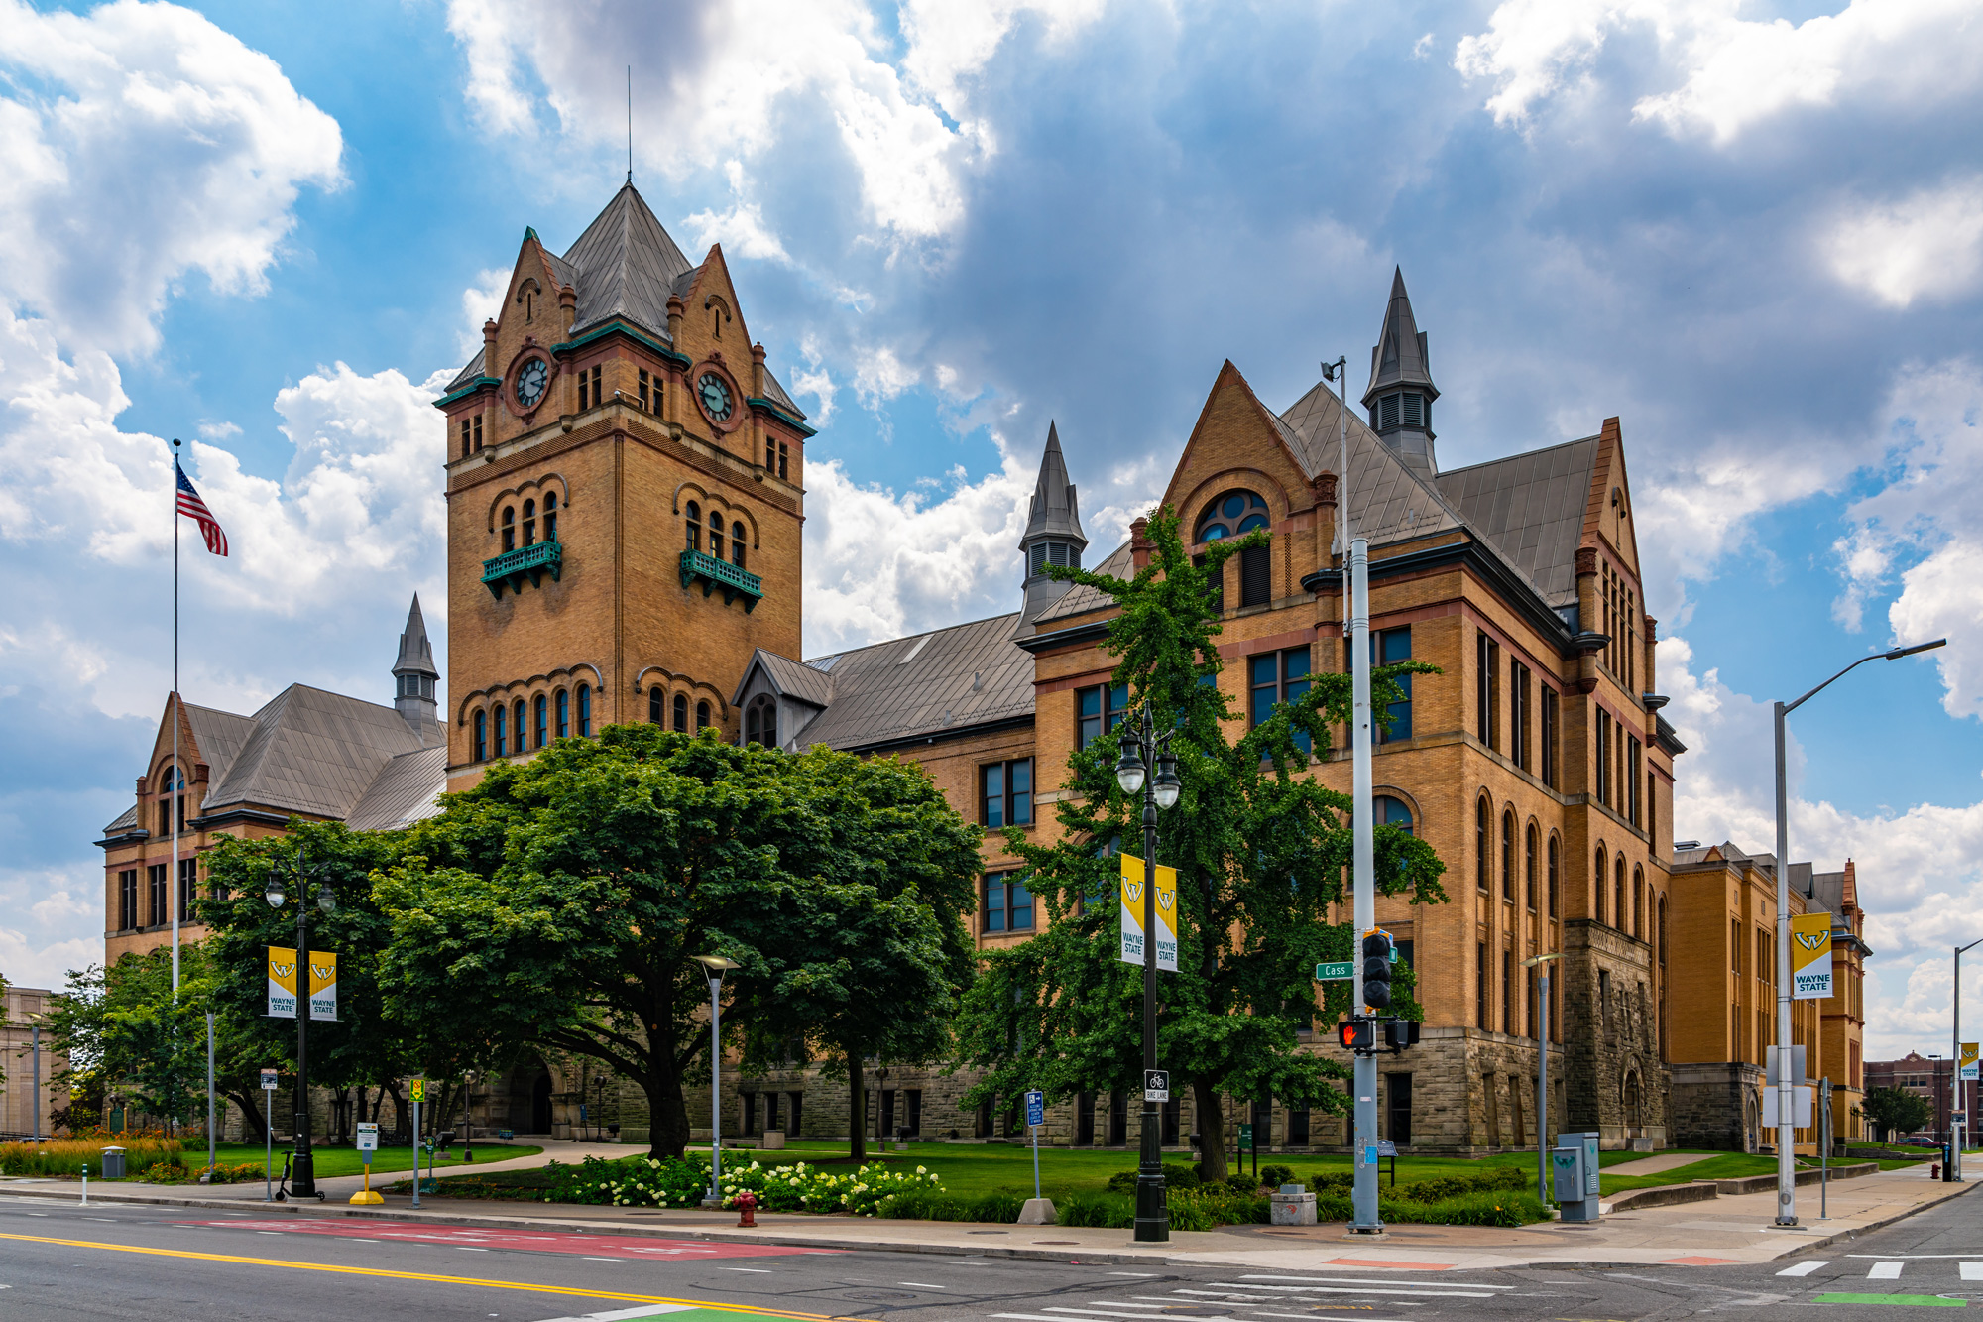
Title – this is a 60” x 36” (5’ x 3’) poster, 88 point lato heavy title heading, legible at 16 feet away when printed at 200%
Authors and affiliations
56 point lato medium body when printed at 200%
Introduction
Methods
Conclusion
Any poster that is meant to be read at a minimum distance; the following sizes are suggested:
Title: 88 pt bolded
Authors and affiliations: 54 - 60 pt
Headings: 48 pt
Body text: 24 - 32 pt
Captions: 20 pt
For readability, the following sizes are suggested for the body text:
To be legible at 6 feet use 30 point. (most common for conferences)
To be legible at 10 feet use 48 point.
To be legible at 12 feet use 60 point.
To be legible at 14 feet use 72 point.
Text and figures should be readable from around 5-7 feet away
Use a sans serif typeface (e.g., Lato, Arial, Open Sans, Helvetica, etc.). Our poster templates use the sans serif font Lato, which can be downloaded from the link provided on our FAQ page or from Google: https://fonts.google.com/specimen/Lato
This poster uses Lato font and the theme has been mapped to that font. If you copy/paste text from documents, please ensure fonts are correct. Mismatched fonts in posters are a distraction and aesthetically degrades the quality of your presentation.
For more information about creating accessible design with color and type, please reference https://medcom.med.wayne.edu/creating-accessible-design
Text – good examples
Text should be high contrast, the following provide the best contrast for reading and printing:
Black on white
WSU primary green on white
Dark gray on white
WSU primary green on WSU primary yellow
WSU primary yellow on WSU primary green
White on WSU primary green
Text – poor/inaccessible examples
Text should be high contrast, the example to the right illustrates the worst examples of contrast, making it inaccessible for individuals that have vision impairment. This is what's called “designed to fail” as this assumes everyone can read the content, however, it does the opposite – it excludes people with vision impairments (and even good sighted individuals).
Black on white
Light green on WSU primary green
Dark gray on WSU primary green
White on WSU primary yellow
Black on WSU primary green
Red on WSU primary green
Red does not mean this is important! When deciding to change your content's font color for important information, ensure the font color is not the only means of identification. Bolding, italicizing and scale can function as indicators of importance.
WSU color branding quick guide.
For detailed information about WSU color branding, please visit the FAQ section on our website and select the WSU color under the WSU branding section.
WSU primary green
hex (#0c5449) rgb (12, 84, 73)
WSU primary yellow
hex (#ffcc33) rgb (255, 204, 51)
Grey accent
hex (#d9d9d9) rgb (217, 217, 217)
Below are 3 accent gradients you can use as part of the WSU color branding.
Results
High resolution WSU logos. Proportionally scaled down. If you need to enlarge, please LOCK ASPECT RATIO in the shape format tab! Do not stretch or scale without aspect ratio selected or scale above 100%.
Include a brief caption for figure(s), and explicitly refer to the figure in the text, which includes labeling with legible fonts and font sizes
Figures (Figure 1) should advance the points you’re making in the text
Ensure images and figures (Figure 2) are sufficiently high resolution for enlargement (Figure 3)
Figure 1 - reference figures in your poster. Suggested caption text size is 18 point
References
References
References
We hope you find these tips helpful! If you have any questions, please call the department of Medical Communications at Wayne State University School of Medicine at 313-577-1482 or email medcom@med.wayne.edu We are open Monday through Friday, 8:30 a.m. through 5 p.m. and closed for university recognized holidays.
Figure 2 – example chart
Figure 3 – example chart

